Slide 1
[GapTec]
Guitar Playing Techniques Classification
Li, Weixin
Lyu, Jialun
Lyu, Jishi
Zhu, Yidi
Wang, Yudi
Peng, He
Team 10

Slide 2
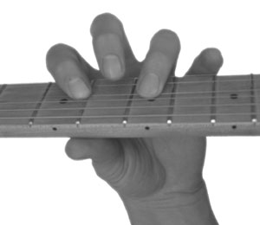
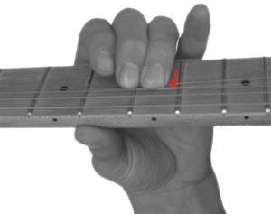
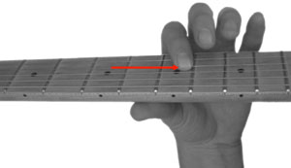
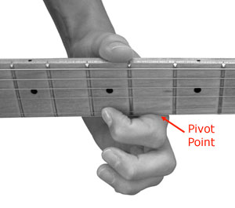
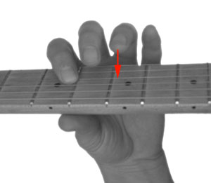

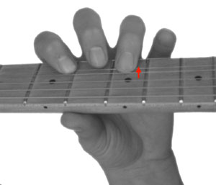
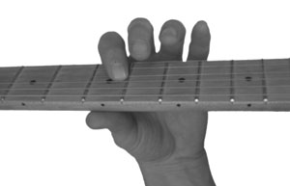
Playing Techniques
hammer-on pull-off bending sliding vibrato
https://www.guitarlessonworld.com/lessons/7-beginner-guitar-playing-techniques/

Slide 3
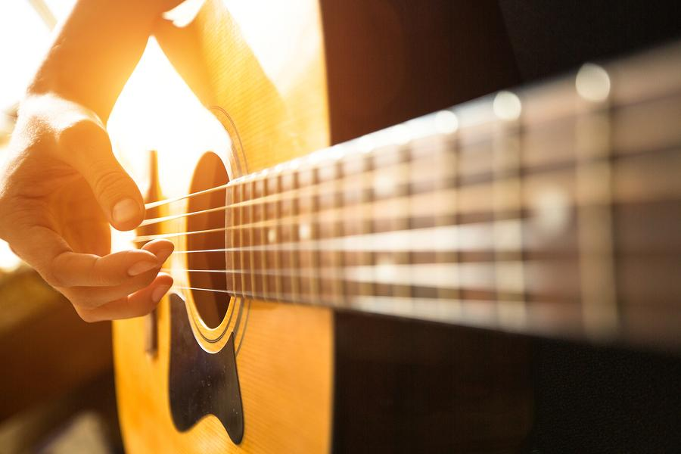
Research Goals
Teach machine to classify 7 different guitar playing techniques
Comparing and developing suitable machine learning algorithm
Enhance the interactivity of guitar learning experience

Slide 4
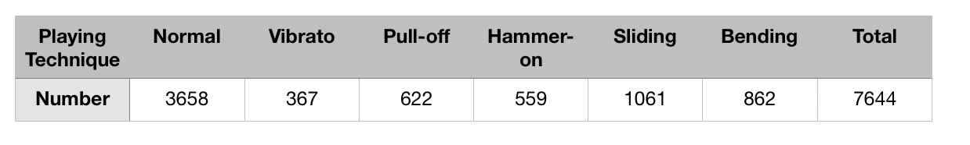
Dataset: 80% training + 20% testing
Recorded by professional guitarist:
Guitar: ESP’s MII with Seymour Duncan’s pickup and Ebony finger board
Recording interface: PreSonus’ AudioBox USB
Bit depth: 24 bits
Frequency response: 14 Hz - 70 kHz
Post-production:
Augment each audio clips to 7 different guitar tones,
involving different levels of distortion, reverb, delay and chorus
Dataset: http://mac.citi.sinica.edu.tw/GuitarTranscription/

Slide 5
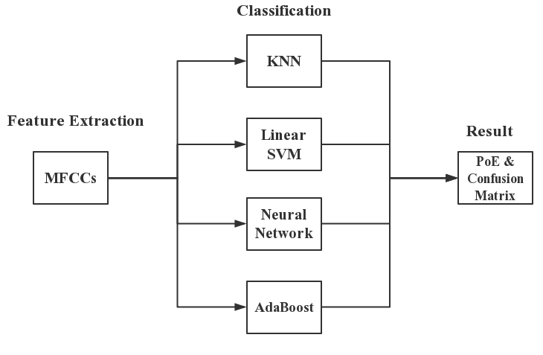
Workflow

Slide 6
Feature Extraction

Slide 7
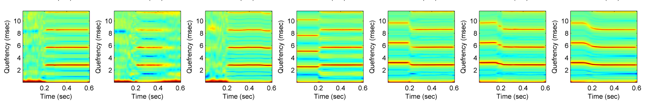
Onset Detection
Short-Time Cepstrum
normal muting vibrato pull-off hammer-on sliding bending
Su, L., Yu, L. F., & Yang, Y. H. (2014, October). Sparse Cepstral, Phase Codes for Guitar Playing Technique Classification. In ISMIR (pp. 9-14)
Notes:
the playing techniques can be better identified around the onsets for most cases, use the well-known spectral flux method for onset detection

Slide 8
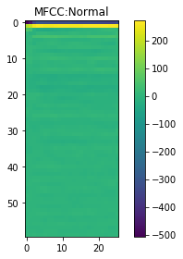
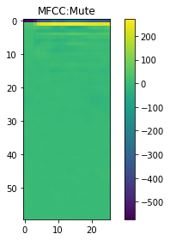
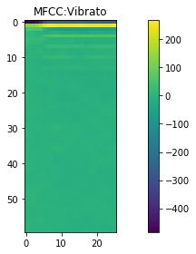
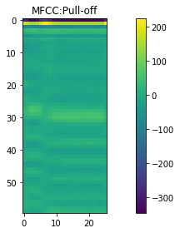
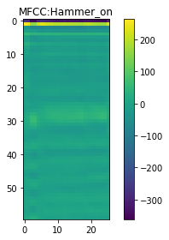
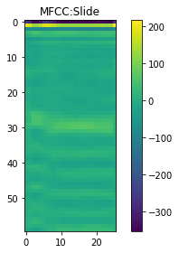
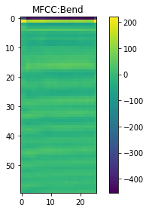
Mel-frequency Cepstral Coefficients (MFCCs)
normal muting vibrato pull-off hammer-on sliding bending
Mel-frequency Cepstrum (MFC): In sound processing, the mel-frequency cepstrum is a representation of the short-term power spectrum of a sound, based on a linear cosine transform of a log power spectrum on a nonlinear mel scale of frequency. Mel-frequency cepstral coefficients are coefficients that collectively make up an MFC.

Slide 9
Classification Results

Slide 10
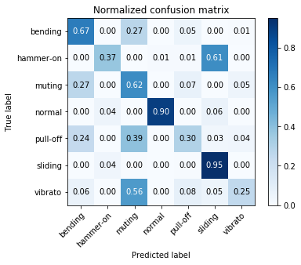
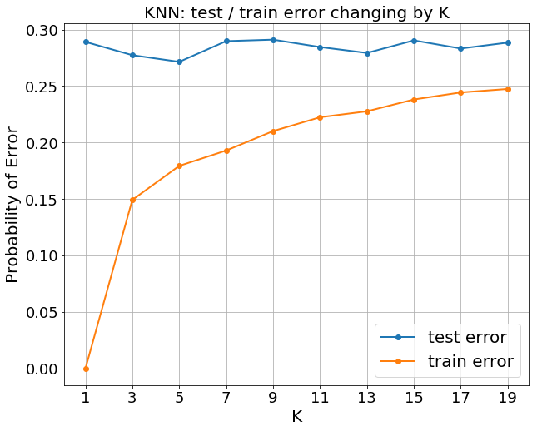
k-Nearest Neighbors (KNN)
When K = 5: Test PoE: 27.14% Train PoE: 17.94%
Notes:
Can mention that the United States is excluded

Slide 11
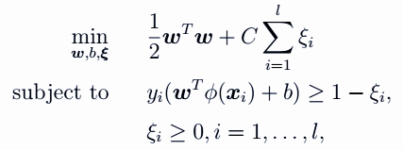
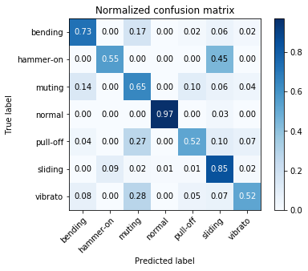
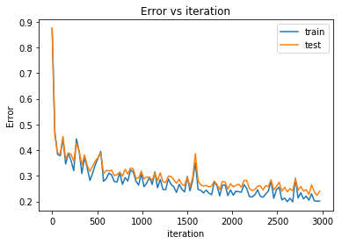
Linear SVM
Parameter
C=4
Test PoE: 25.71% Train PoE: 20.62%

Slide 12
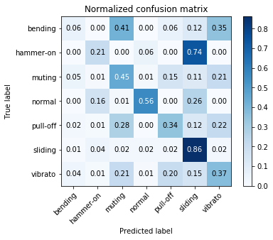
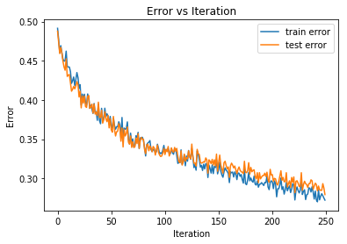
Neural Network
Net structure : 520 -> 100 -> 7
Activation function : ReLU
Mini-batch gradient descent (100/mini-batch)
Test PoE: 27% Train PoE : 26%

Slide 13
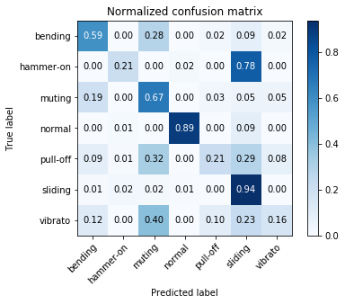
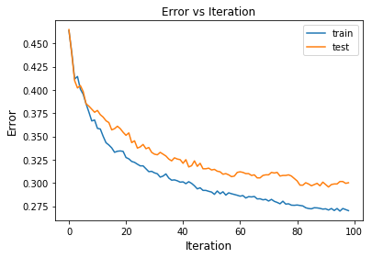
AdaBoost
Exponential loss
Ensemble Learner: decision stump * 250
Test PoE: 30.03% Train PoE: 27.03%

Slide 14
Summary

Slide 15
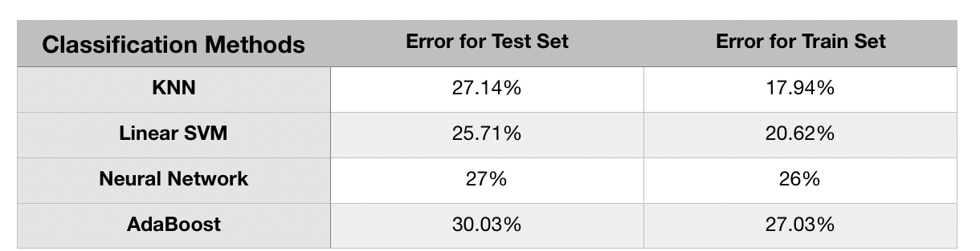
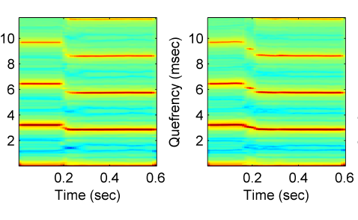
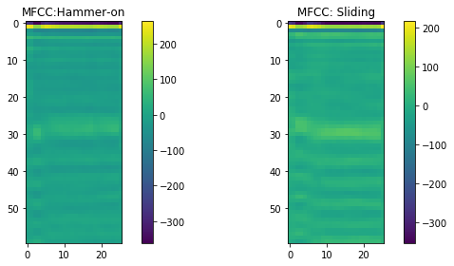
Comparison and Analysis
Best Accuracy - 75% / Paper Accuracy- 80%
Easiest recognized techniques
Normal & Sliding
Hardest recognized pair
Hammer-on & Sliding
hammer-on sliding

Slide 16
Prospect
Further research should focus on...
Raw signal/data preprocess:
more comprehensive and representative
Feature extraction and classification models: more specific
Implementation of deep learning methods
Future Application
Apps: Guitar Self-learn Helper Evaluation & Scoring

Slide 17
References
Barbancho, A. M., Klapuri, A., Tardón, L. J., & Barbancho, I. (2012). Automatic transcription of guitar chords and fingering from audio. IEEE Transactions on Audio, Speech, and Language Processing, 20( 3), 915-921.
Scaringella, N., Zoia, G., & Mlynek, D. (2006). Automatic genre classification of music content: a survey. IEEE Signal Processing Magazine , 23 (2), 133-141.
Creme, M., Burlin, C., & Lenain, R. (2016). Music genre classification.
Benetos, E., Dixon, S., Giannoulis, D., Kirchhoff, H., & Klapuri, A. (2013). Automatic music transcription: challenges and future directions. Journal of Intelligent Information Systems , 41 (3), 407-434.
Chathuranga, Y. M. D., & Jayaratne, K. L. (2018). Automatic music genre classification of audio signals with machine learning approaches. GSTF Journal on Computing (JoC) , 3 (2).
Reboursière, L., Lähdeoja, O., Drugman, T., Dupont, S., Picard-Limpens, C., & Riche, N. (2012, May). Left and right-hand guitar playing techniques detection. In NIME .
Su, L., Yu, L. F., & Yang, Y. H. (2014, October). Sparse Cepstral, Phase Codes for Guitar Playing Technique Classification. In ISMIR (pp. 9-14).
Murthy, Y. V., & Koolagudi, S. G. (2018). Content-Based Music Information Retrieval (CB-MIR) and Its Applications toward the Music Industry: A Review. ACM Computing Surveys (CSUR) , 51 (3), 45.
Lasseck, M. (2018). Audio-based bird species identification with deep convolutional neural networks. Working Notes of CLEF , 2018 .
Lartillot, O., & Toiviainen, P. (2007, September). A Matlab toolbox for musical feature extraction from audio. In International conference on digital audio effects (pp. 237-244).
Nam, J., Herrera, J., Slaney, M., & Smith, J. O. (2012, October). Learning Sparse Feature Representations for Music Annotation and Retrieval. In ISMIR (pp. 565-570).

